Slide 1
my cla4
Two runs, two slightly different builds

Slide 2
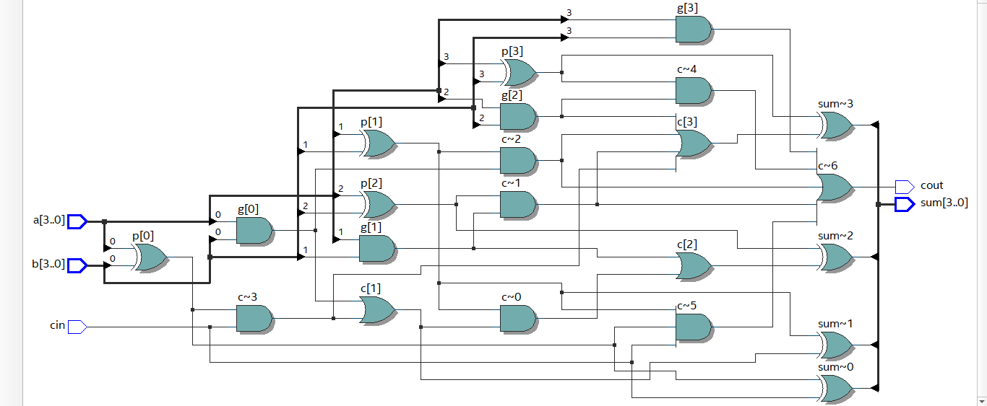
Build 1

Slide 3
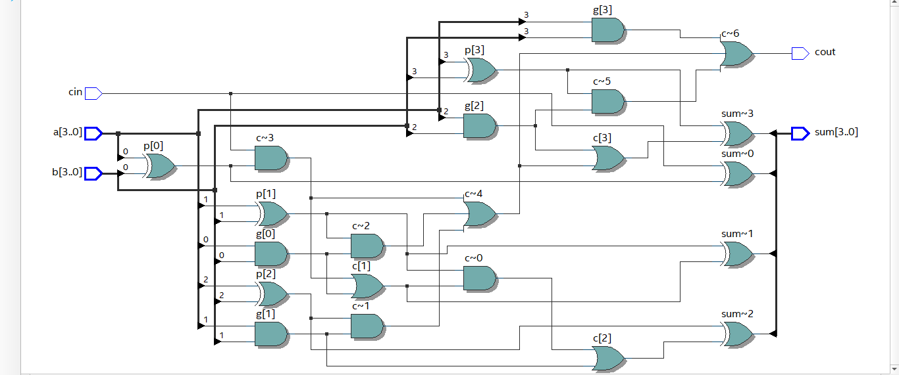
Build 2

Slide 4
What Do You Notice?
Build 1: 8 XOR, 10 AND, 3 OR, 21 total, critical path 6 gates long
Build 2: 8 XOR, 9 AND, 4 OR, 21 total, critical path 6 gates long
We know, of course, that the actual implementation will use ALUTs

